Slide 1
Quadrotor Top Inverted Pendulum (Q-TIP)
Controller design and synthesis

Slide 2
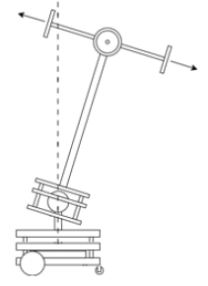
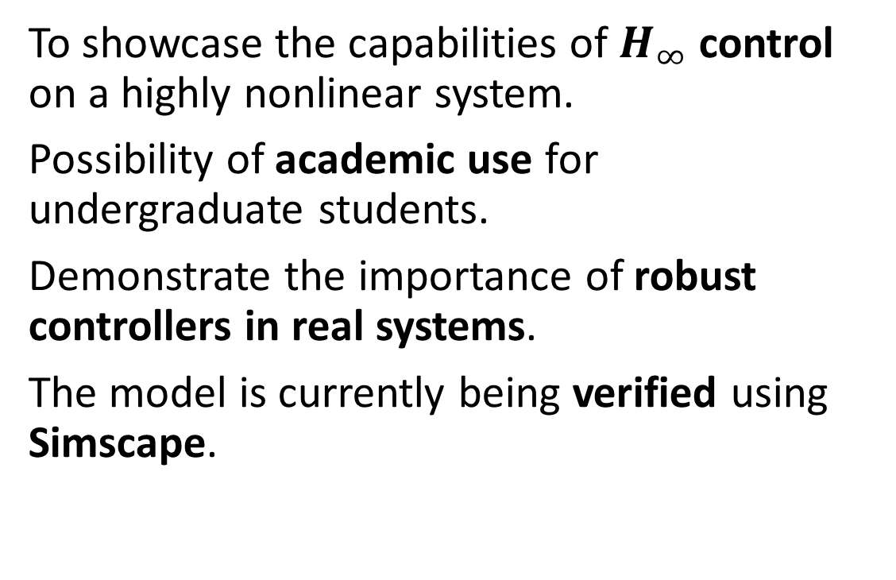
Q-TIP: Purpose
To showcase the capabilities of $H_{∞}$ control on a highly nonlinear system.
Possibility of academic use for undergraduate students.
Demonstrate the importance of robust controllers in real systems.
The model is currently being verified using Simscape.

Slide 3
H-infinity loop-shaping
Advantages:
Easily applicable to MIMO systems.
Similarly to LQR, the control problem is formulated as an optimisation problem.
Can be designed for the nominal model and applied to the real model.
Loop-shaping weights the plant transfer function in the frequency domain to minimise the sensitivity to noise, disturbances and plant-model mismatch.
Disadvantages:
Need a reasonably good model for the system to be controlled.
Controller is only optimal in relation to the selected cost function.

Slide 4
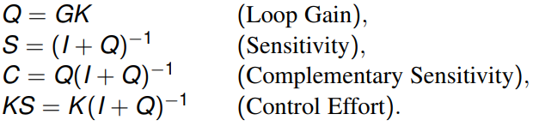


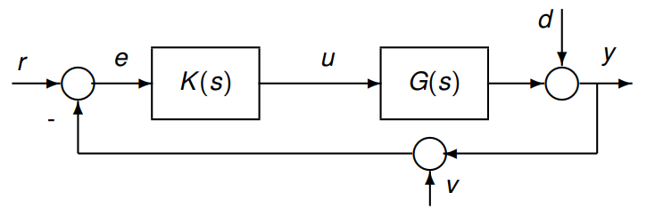


H-infinity loop-shaping
Good tracking
Noise attenuation,
Under multiplicative uncertainty
Robust under additive uncertainty

Slide 5
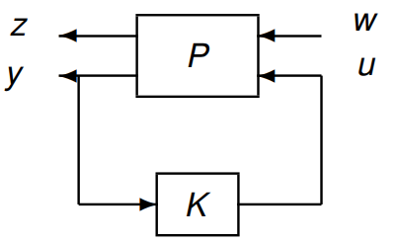
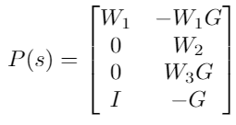
MATLAB Robust Control Toolbox
augment/AUGW
hinfsyn

Slide 6
Simulink Simscape Multibody
A powerful tool for simulating and visualising electromechanical systems.
Uses a reference frames and bodies along with physical bodies to build a model.
Can be linearised and extracted using linmod.

Slide 7
Next steps and problems to be solved
Testing of parts and subsystems.
Estimation of parameters.
Motor modelling.
Measuring the buggy yaw

